Slide 1
What is Machine Learning?

Slide 2
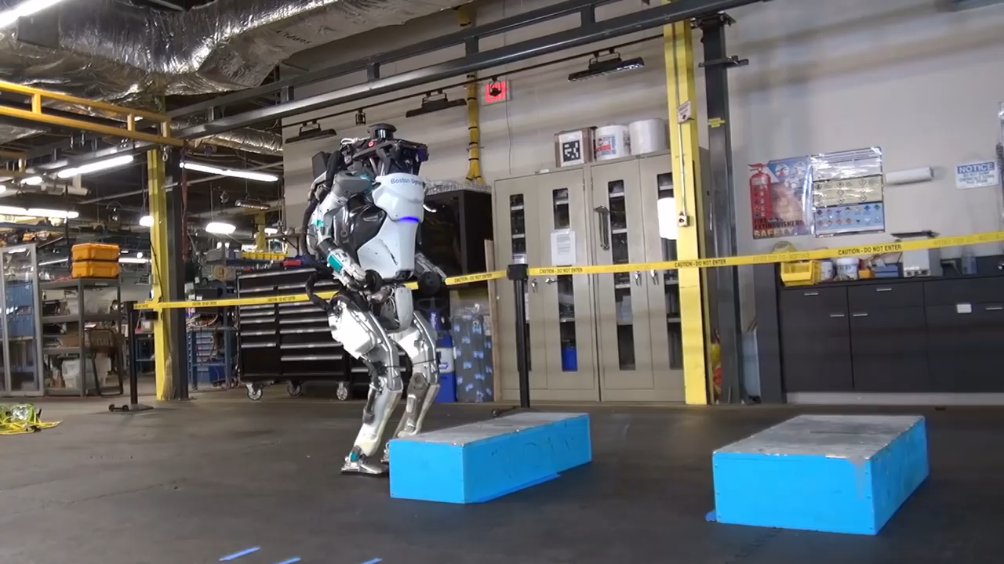
Notes:
The essence of Machine Learning: a machine that learns.

Slide 3
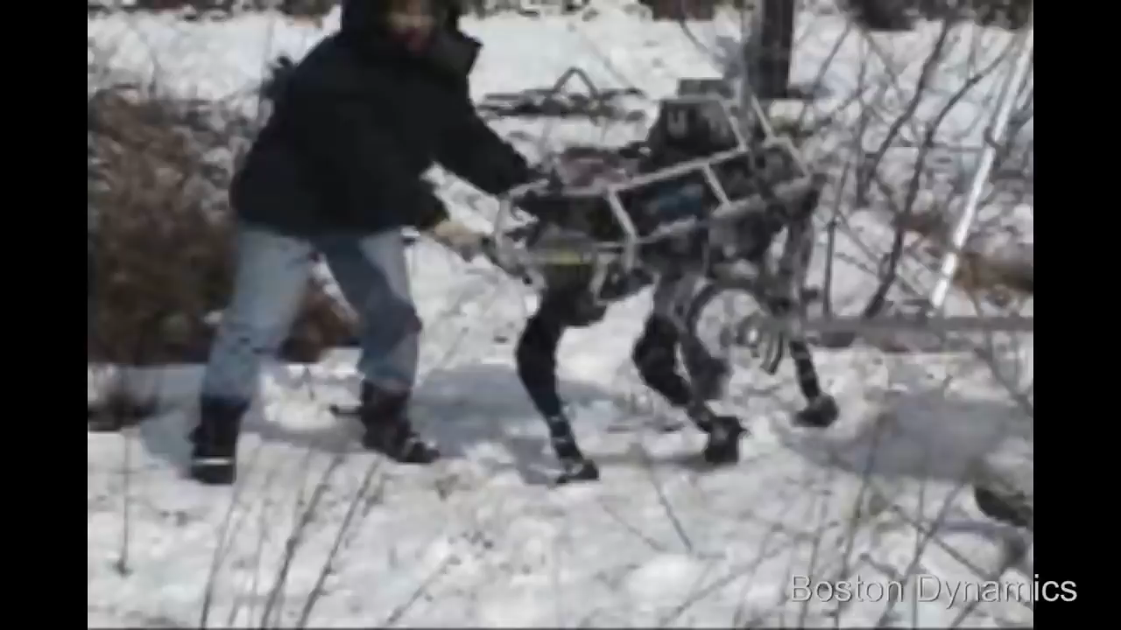
Notes:
Goed gedrag word beloond, slecht gedrag afgetraft.
Genet knows this: she has children
Das ook zo bij de cost function.

Slide 4
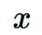
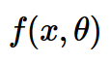
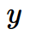
Dataset
Learning Algorithm

Slide 5
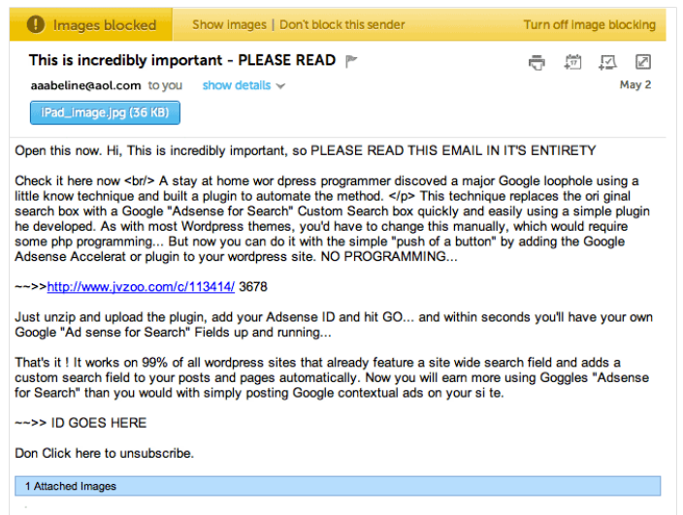

Slide 6
Dataset
Learning Algorithm
{SPAM,NOT SPAM}

Slide 7
Dataset
Learning Algorithm
ACCGTGAACTGTCTTGAAGTAC
{SPLICE SITE,NOT SPLICE SITE}

Slide 8
Marketing: personalised ads, chatbots, “Adblock Plus”
Search engines: NLP
Social media: “people you may know”, facial recognition
Healthcare: diagnosis, anticipation, workflow optimization, automation
Biotechnology: genome annotation, expression analysis, protein quantifcation
Robotics: unprogrammable
Industry: workflow optimization, decision making
Notes:
Social media: manipulaton

Slide 9
concepts

Slide 10
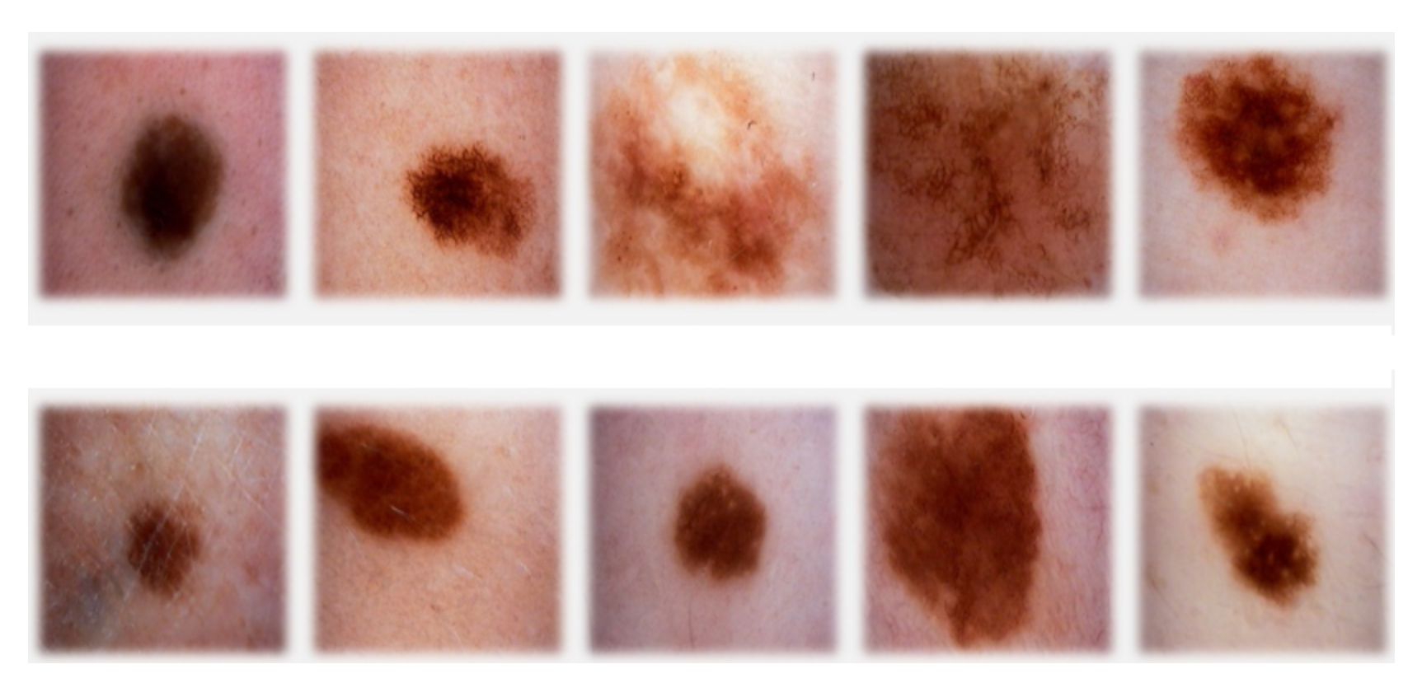
sign of cancer
top row malignant
bottom row benign

Slide 11
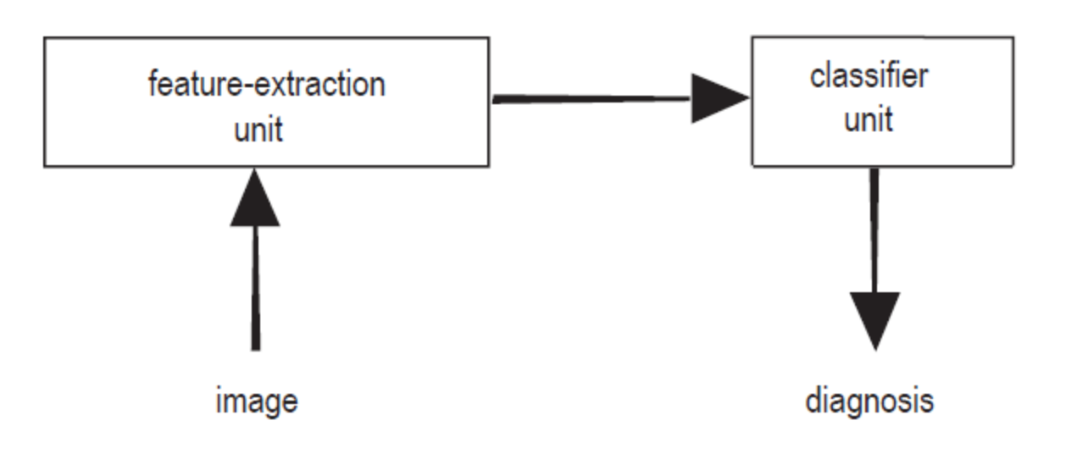
feature extraction: features (a.k.a. properties or attributes)
data set, sample (a.k.a. example, instance or data point), label (a.k.a. target)
Notes:
Welk feature?

Slide 12
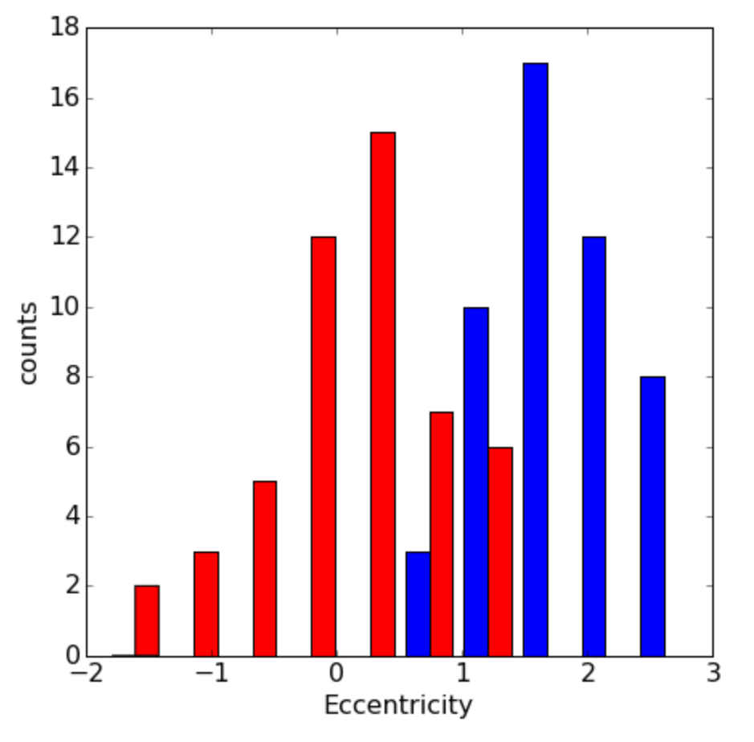
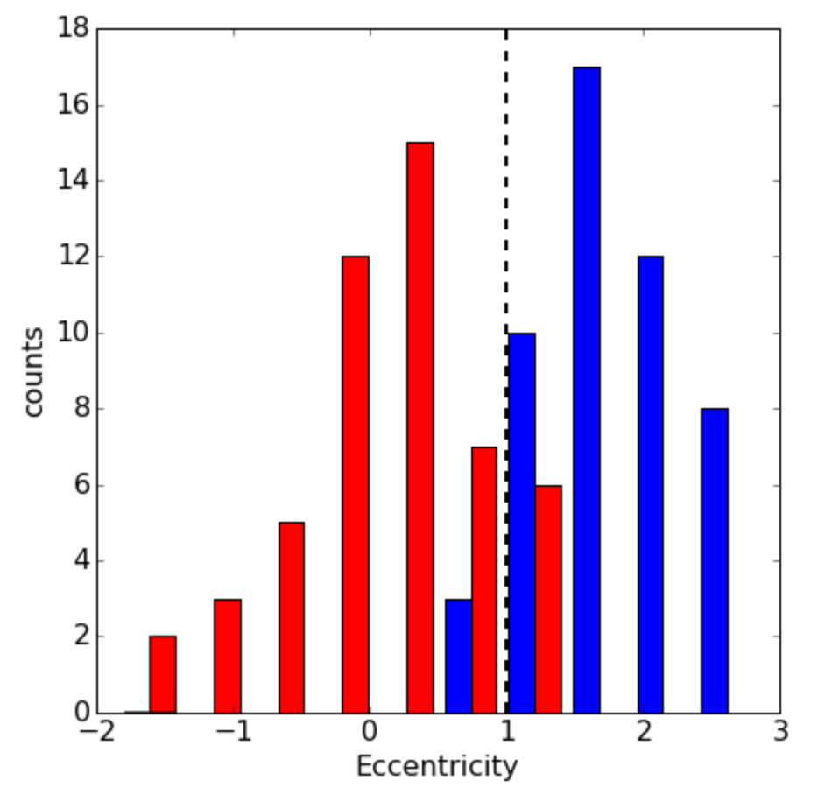

eccentricity of lesion (how nearly circular the lesion is)
threshold t
consequence of the predictions

Slide 13
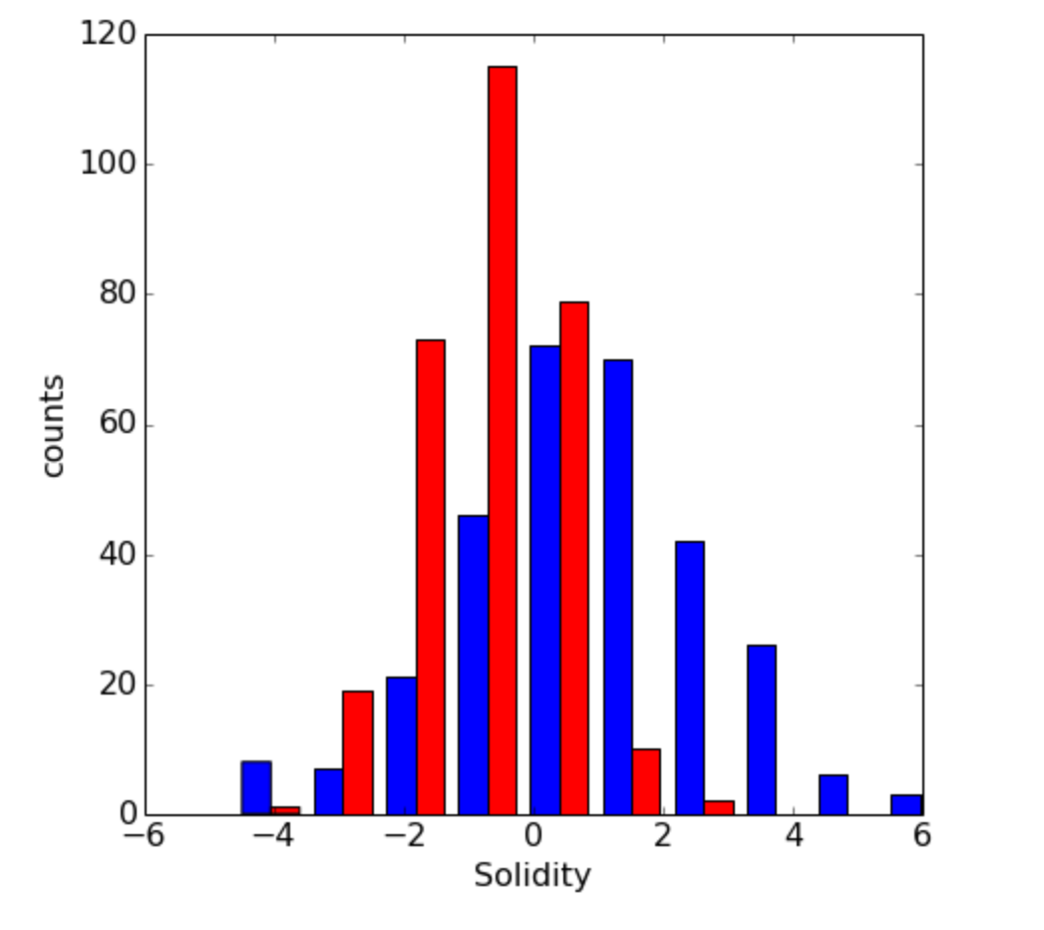
add another feature?
feature vector X
Euclidean vector space
Notes:
the quality or state of being firm or strong in structure

Slide 14
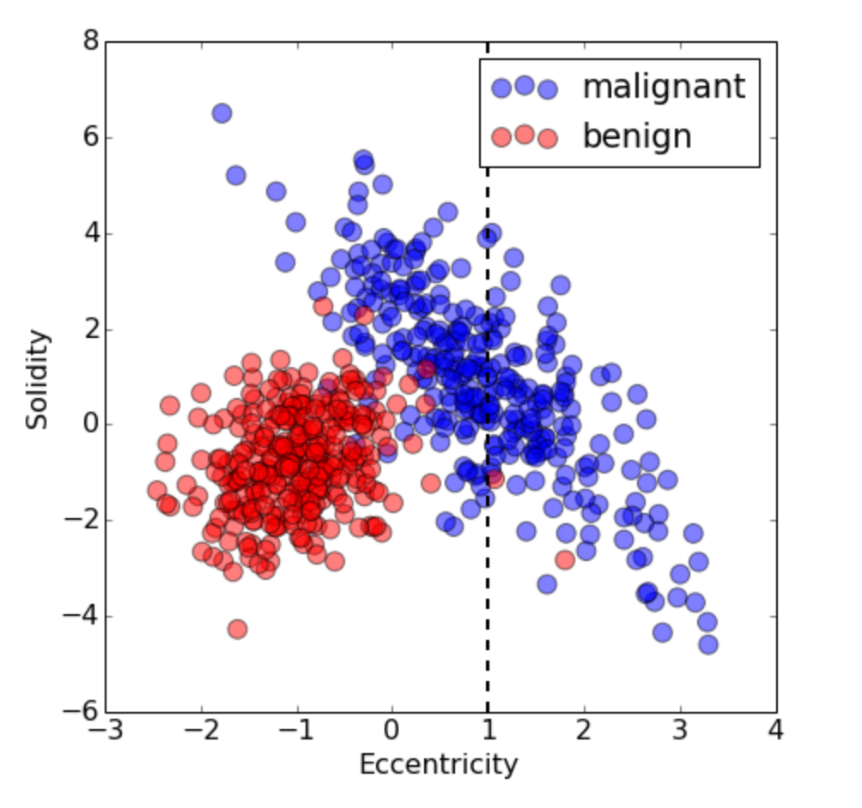
feature vector X
Euclidean vector space

Slide 15
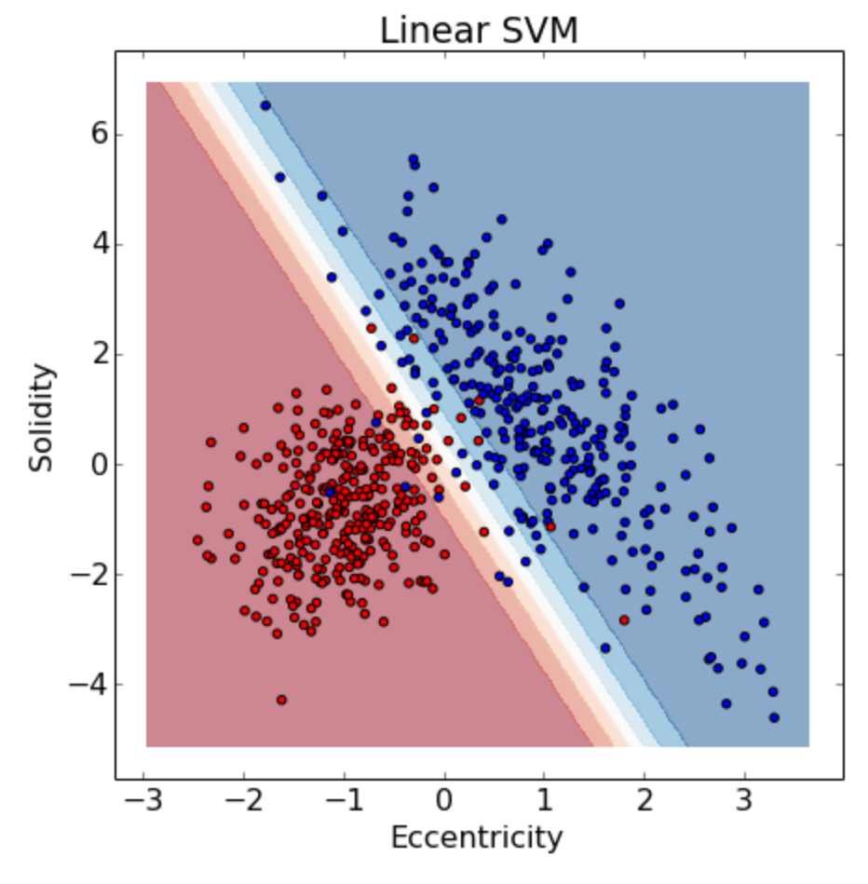
linear decision boundary
blue region malignant, red region benign
yet more features
can’t look at the decision boundary
more complex

Slide 16
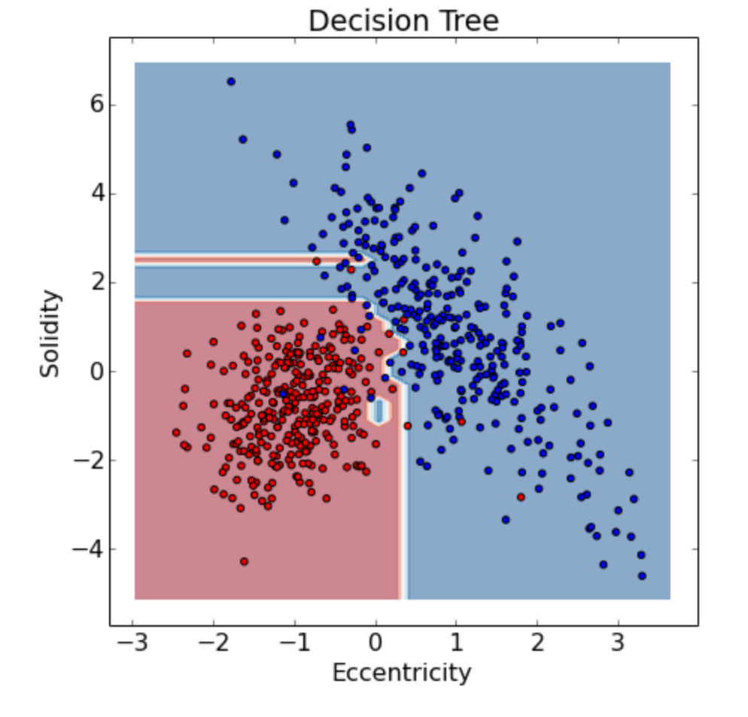
unseen external images
generalization
overfitting

Slide 17
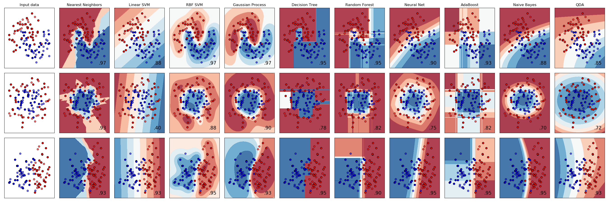

Slide 18
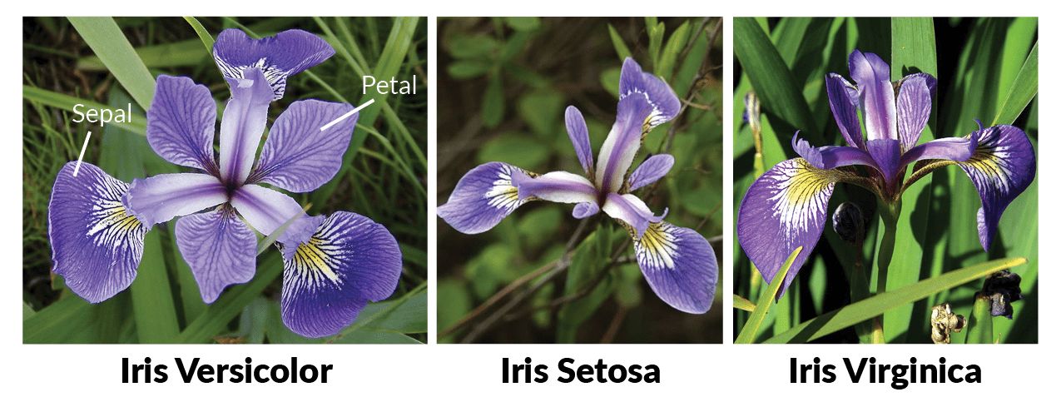

Slide 19
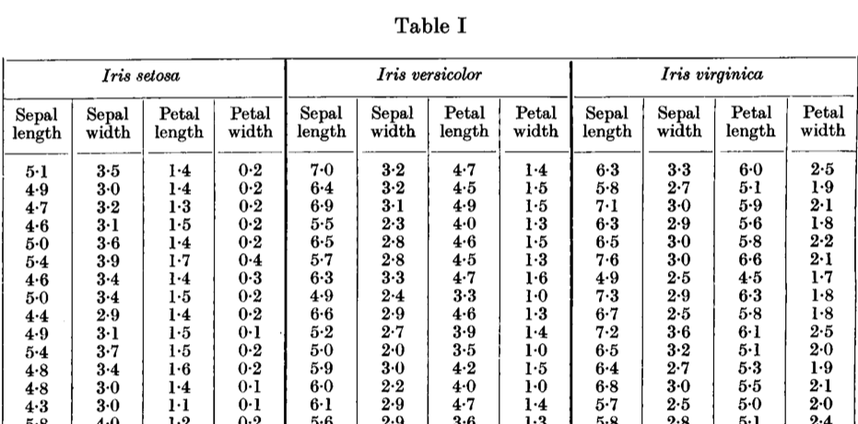
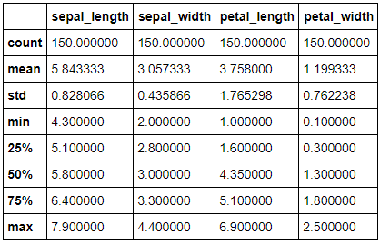
Fisher R., The use of multiple measurements in taxonomic problems (1936)

Slide 20
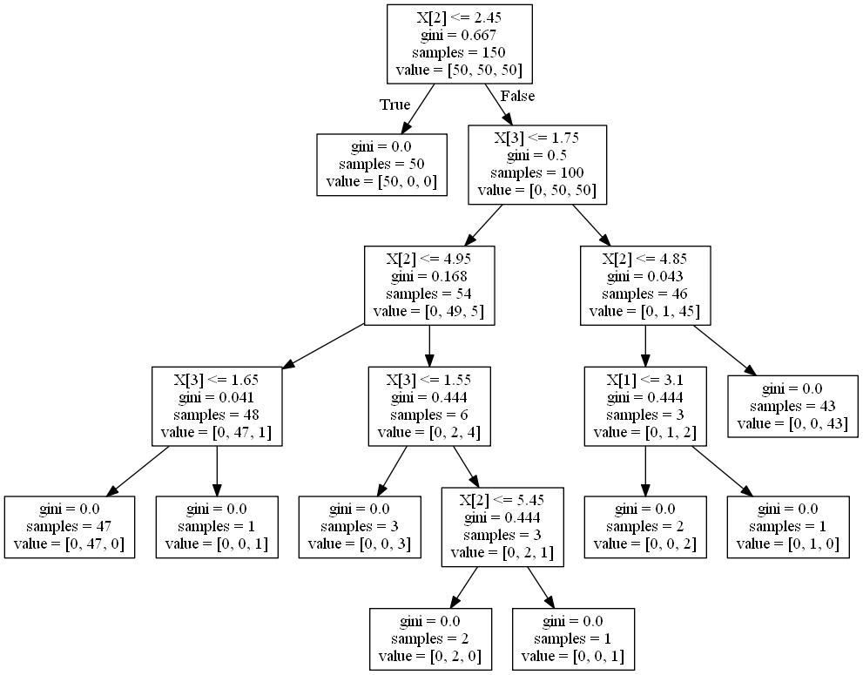
Notes:
Class Setosa is easy!!

Slide 21
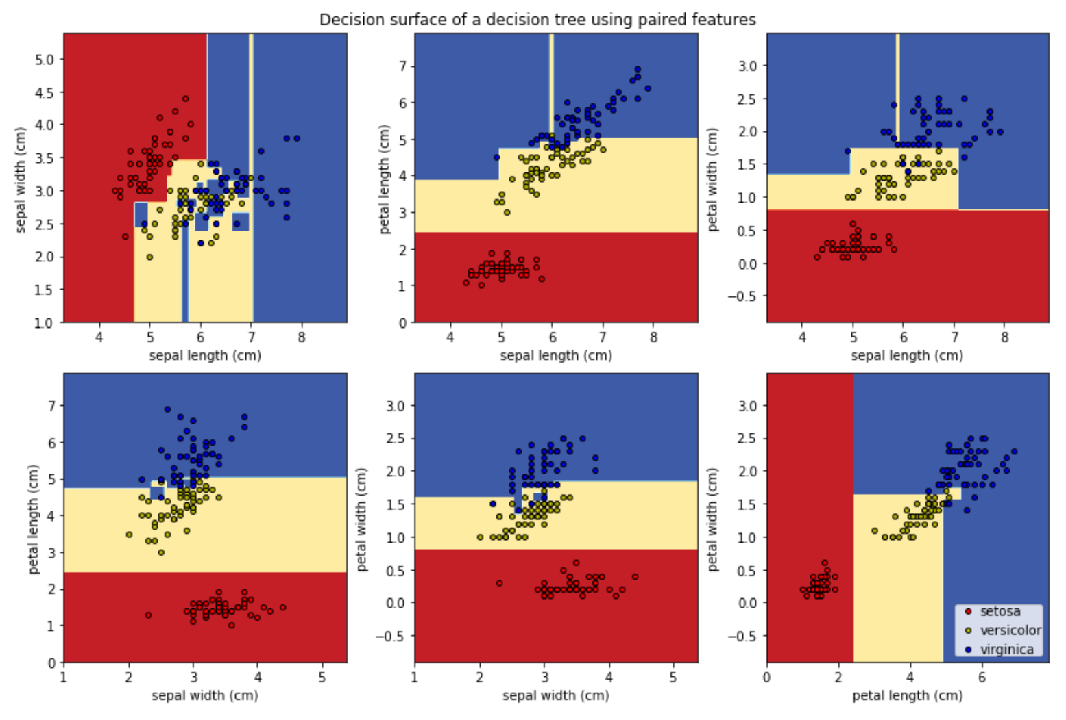
Notes:
Class Setosa is easy, and can be done wit other features as well!!!

Slide 22
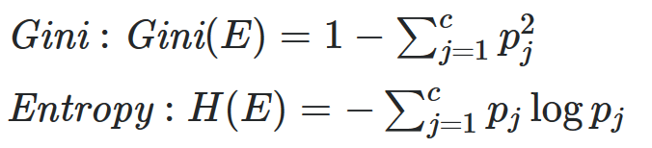
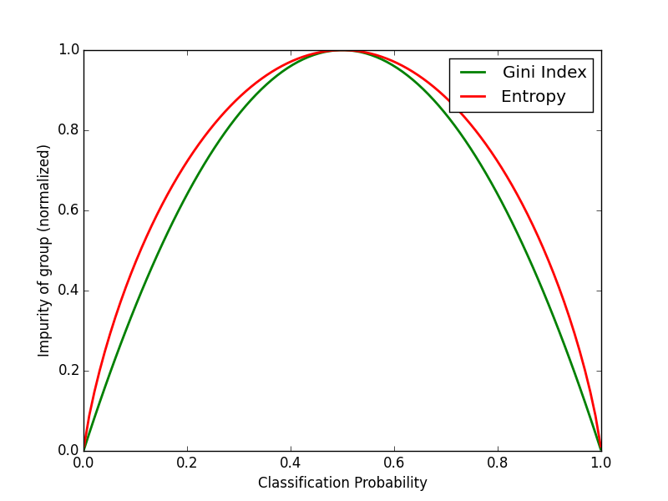
[ p₁, p₂, p₃ ]
Notes:
Class Setosa is easy!!

Slide 23
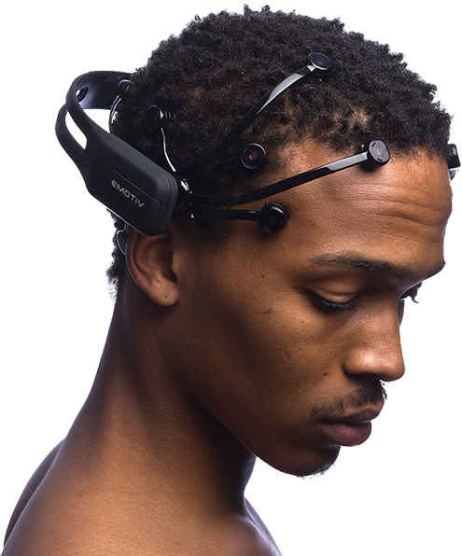
Let’s get real!
Building a decision tree
Kaggle evaluation
The test set
Hyperparameters

Slide 24
advantages:
ease of interpretation
handles continuous and discrete features
invariant to monotone transformation of features
variable selection automated
low bias (deep trees)
disadvantages:
high variance
overfitting
Notes:
Class Setosa is easy!!

Slide 25
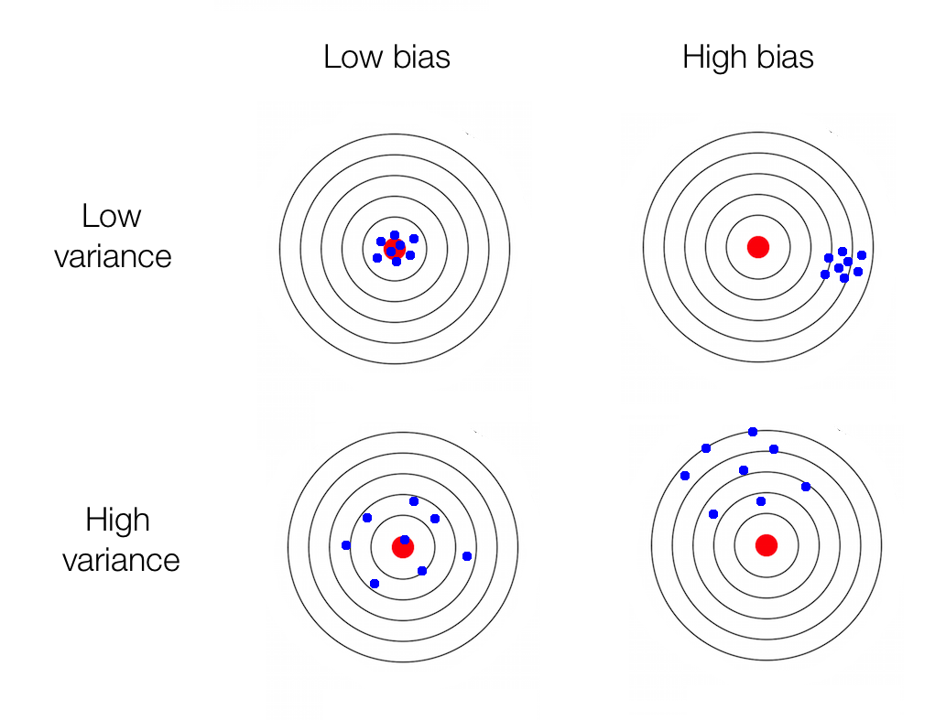
Notes:
Mogelijk om variance te verkleinen door pruning or early stopping -> but increases bias!!

Slide 26


Slide 27
boosting
bagging

Slide 28
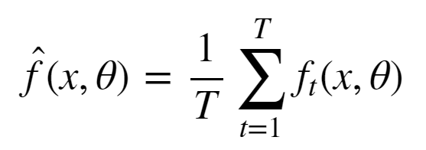
Bagging
Simulate the notion of different train set samples:
sample data points from train set to create new train set
fit low bias high variance model on new train set
repeat steps (1) and (2) T times
average the predictions of the T models

Slide 29
Bagging: Random Forests
Train set contains n data points with m features.
Construct T low bias high variance decision trees by following these steps:
Sample n data points at random with replacement from the train set.
At each node, select h<<m features at random and compute the best split using only these h features.
Each tree is grown to the largest extent possible. There is no pruning or early stopping.
Step 3 ensures that the bagged models are low bias by learning deep complex decision trees.

Slide 30
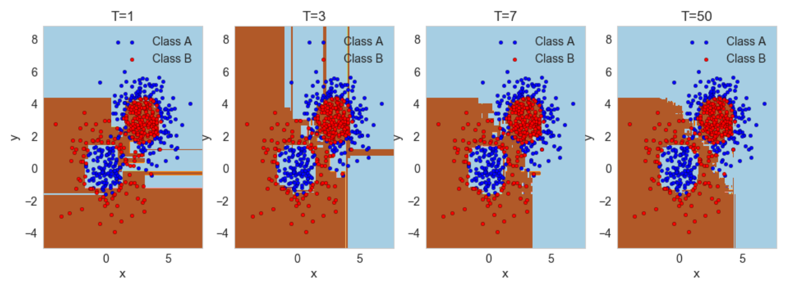
Bagging: Random Forests

Slide 31
Let’s get real!
5. Ensemble learning: bagging

Slide 33
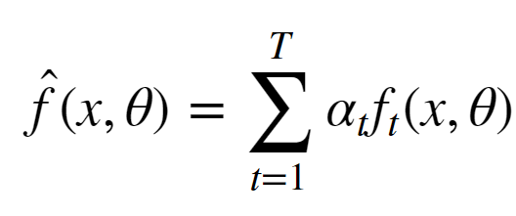
Boosting
reduce the bias of a high bias low variance model
turning an ensemble of weak learners into a strong learner
the meta-model is additive, i.e. adaboost:

Slide 34
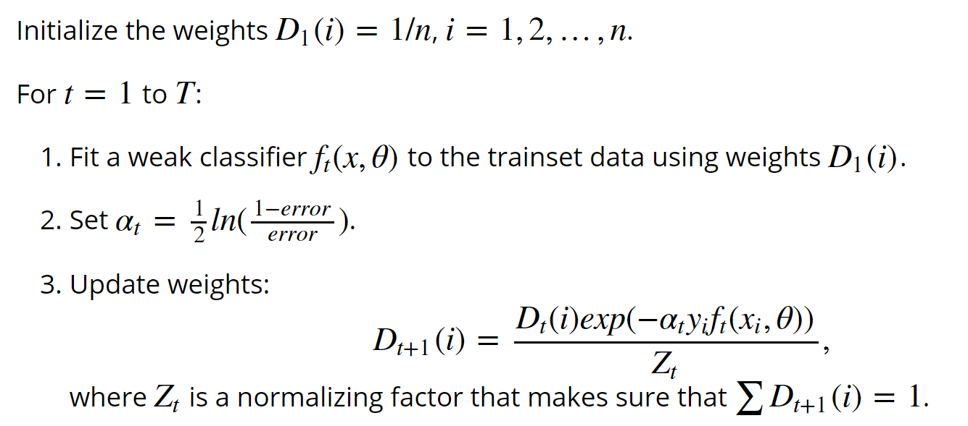
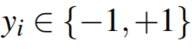
Boosting: adaboost

Slide 35
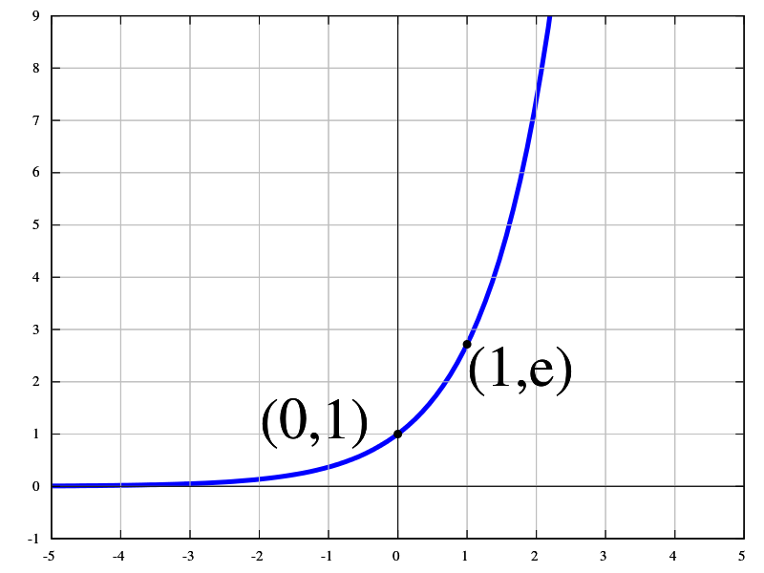

Slide 36
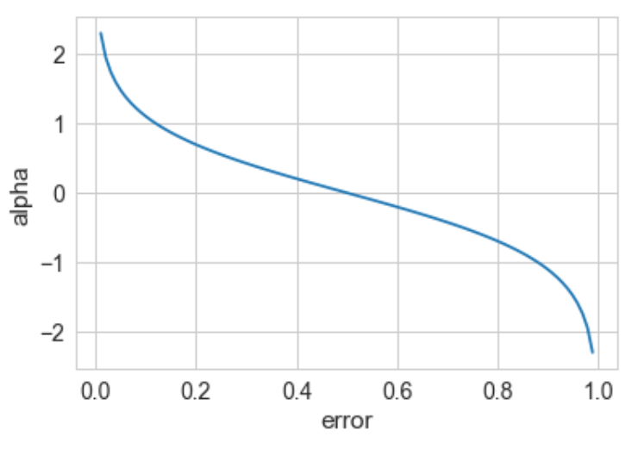
Boosting: adaboost
The weight of a weak model in the boosted meta-model increases exponentially as the error approaches 0. Better models are given exponentially more weight.
The weight is zero if the error rate is 0.5. A model with 50% accuracy is no better than random guessing, so it is ignored.
The weight decreases exponentially as the error approaches 1. A negative weight is given to classifiers with worse than 50% accuracy. “Whatever that classifier says, do the opposite!”.

Slide 37
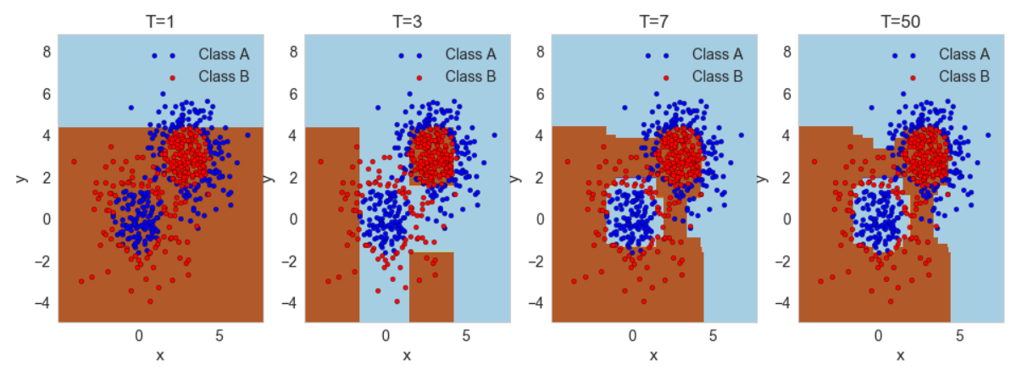
Boosting: adaboost

Slide 38
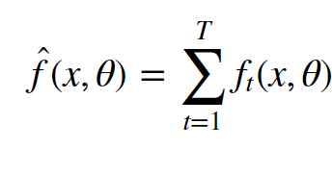
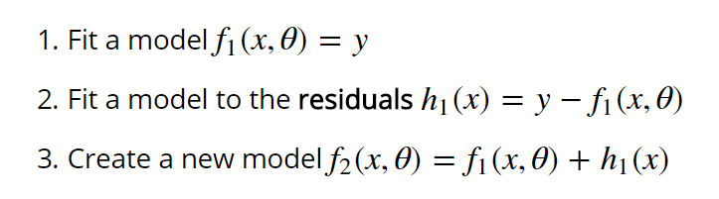
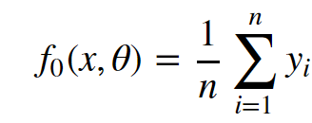
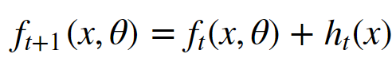
Boosting: Gradient Boosting
Notes:
Remember the red lines –> residuals
If prediction 0.5 to high -> learn that and then substract 0.5 in the next model

Slide 39
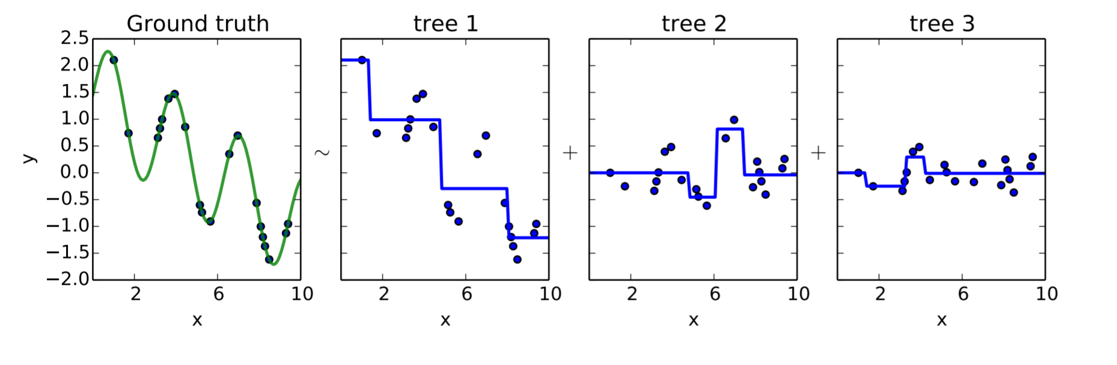

Slide 40
Let’s get real!
6. Ensemble learning: boosting

Slide 41
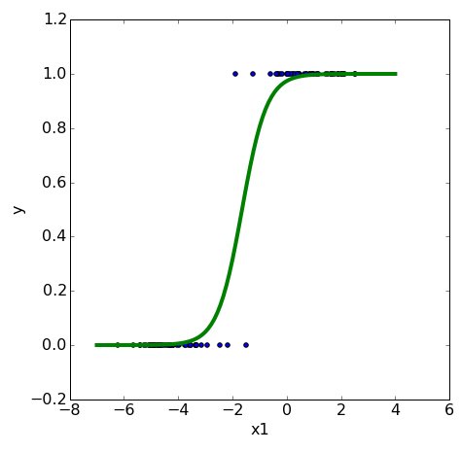
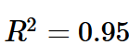
logistic regression
We need to make
assumptions
about the
model
that generated the data.
linearly separable
logistic model

Slide 42
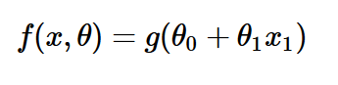
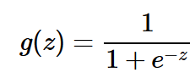
logistic regression: logistic model

Slide 43
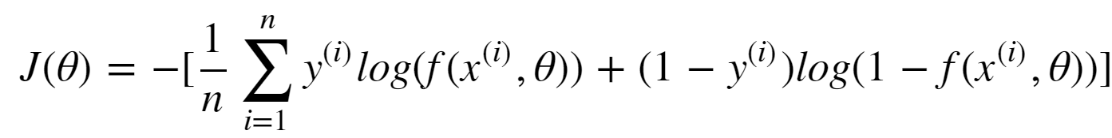
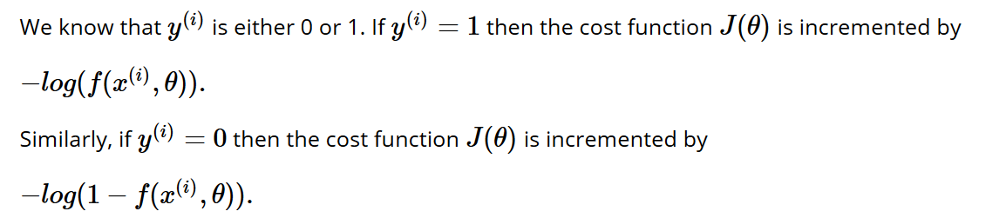
logistic regression: cost function

Slide 44
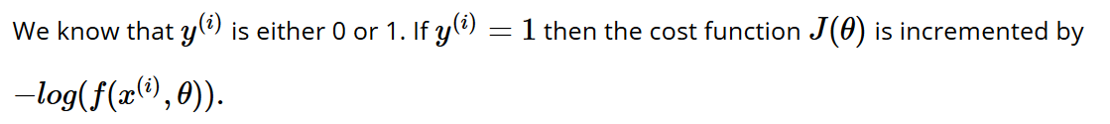
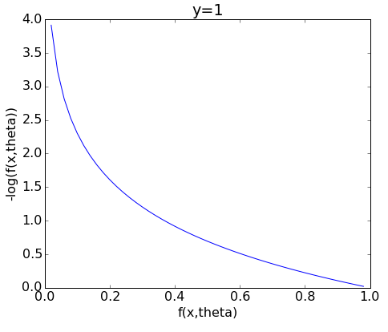
logistic regression: cost function
Notes:
X-as is predictie
Y-as is cost van predictie indien y == 1

Slide 45
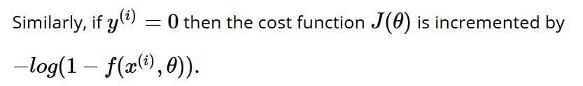
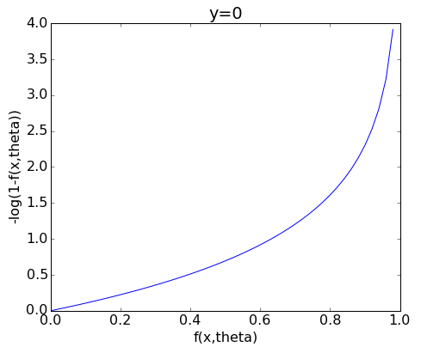
logistic regression: cost function

Slide 46
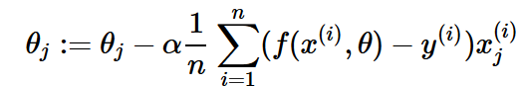
logistic regression
Fit a logistic model
to the data set such that the cost function
is minimal using gradient descent

Slide 47
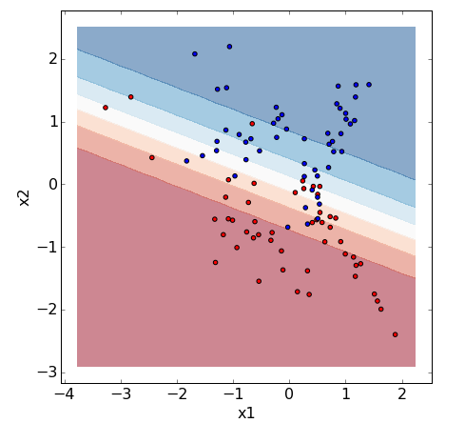
Notes:
Toon de expansie: x1 + x2 + x1^2 + 2*x1*x2 + x2^2

Slide 48
Let’s get real!
7. Logistic regression
8. Non-linear transformations

Slide 49
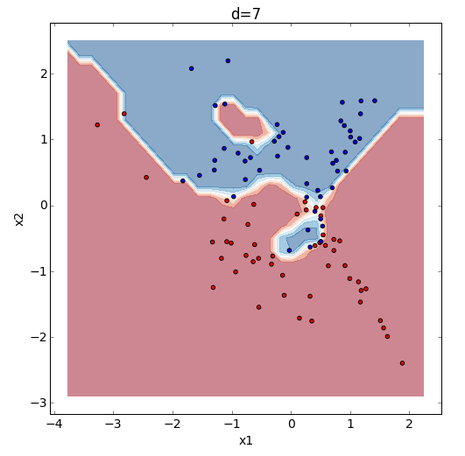
Notes:
Toon de expansie: x1 + x2 + x1^2 + 2*x1*x2 + x2^2

Slide 50



regularized logistic regression
cost function
regularized cost function

Slide 51

regularized logistic regression

Slide 52




support vector machines
Fit a linear model
such that
with and
is minimized.

Slide 53



support vector machines
replace cost function by piecewise linear function
if y = 1 then the contribution to the cost is

Slide 54


support vector machines
replace cost function by piecewise linear function
if y = 1 then the contribution to the cost is
if y = 0 then the contribution to the cost is

Slide 55


kernel support vector machines
Notes:
https://www.youtube.com/watch?v=3liCbRZPrZA

Slide 56





kernel support vector machines
SVMs can also be formulated as a linear function of the samples (dual form) instead of the features as
that can be reformulated as a non-linear function using what is know as a kernel function
to become
The data points for which are called the support vectors.

Slide 57


kernel support vector machines
Notes:
100 features degree 3: 187.460
150 -> 608.685

Slide 58


kernel support vector machines
Notes:
Maak gamma!!!!

Slide 59
Let’s get real!
9. Support Vector Machines

Slide 60


Slide 61







Model:

Slide 62
Cost function logistic regression:
Cost function feedforward neural network:

Slide 63
https://playground.tensorflow.org/

Slide 64
Let’s get real!
10. Neural Networks

Slide 65
Blending/Stacking

Slide 66

https://mlwave.com/kaggle-ensembling-guide/

Slide 67

Notes:
https://www.kaggle.com/dmi3kno/allstate-eda

Slide 68

Notes:
https://www.kaggle.com/dmi3kno/allstate-eda

Slide 69


Slide 70


Slide 71


Slide 72


Slide 73
Convolution

Slide 74

https://github.com/leriomaggio
Notes:
It would have to learn: what is a dog at this position, what is a dog look like slightly higher, or more to the right, or lower, ....

Slide 75

https://github.com/leriomaggio

Slide 76

http://setosa.io/ev/image-kernels/

Slide 77

http://setosa.io/ev/image-kernels/

Slide 78

http://setosa.io/ev/image-kernels/

Slide 79

https://github.com/leriomaggio

Slide 80

https://github.com/leriomaggio

Slide 81

https://github.com/leriomaggio

Slide 82

https://github.com/leriomaggio

Slide 83

https://github.com/leriomaggio

Slide 84


Slide 85


Slide 86


Slide 87


Slide 88

Thrun et al. Dermatologist-level classification of skin cancer with deep neural networks. Nature, January 2017 DOI: 10.1038/nature21056

Slide 89

Thrun et al. Dermatologist-level classification of skin cancer with deep neural networks. Nature, January 2017 DOI: 10.1038/nature21056

Slide 90

Thrun et al. Dermatologist-level classification of skin cancer with deep neural networks. Nature, January 2017 DOI: 10.1038/nature21056

Slide 91

http://people.idsia.ch/~juergen/deeplearningwinsMICCAIgrandchallenge.html
Notes:
Deep Learning Wins ICPR 2012 Contest on Mitosis Detection

Slide 92

Notes:
mamography

Slide 93


Slide 94

https://www.kaggle.com/c/second-annual-data-science-bowl/data

Slide 95

http://people.csail.mit.edu/hongzi/

Slide 96


Slide 97







Slide 98

https://www.youtube.com/watch?v=jCr6rNaZ9EU
Notes:
https://www.youtube.com/watch?v=jCr6rNaZ9EU

